Slide 1
Dymanic Pricing Determination - ReCell
Project 3 – PGP DSBA

Slide 2
Contents / Agenda
Problem Statement/Business Problem overview
Objectives
Data Overview
Exploratory Data Analysis
4.1. Univariate analysis
4.2. Multitivariate analysis
Data Processing
5.1. Miss Value treatment
5.2. Feature Engineering
5.3. Outlier Check
5.4. Data preparation for modelling
Model Building – Linear Regression
6.1. Model Performance check
Checking Linear Regression Assumptions
7.1. Test for Multicollinearity
7.2. Test for Linearity and Independence
7.3. Test for Normality
7.4. Test for Homoscedasticity
Predictions on Data
Final Model Summary
Conclusions and Recommendations
Appendix
Data Preprocessing
5.1. Miss Value treatment
5.2. Feature Engineering
5.3. Outlier Check
5.4. Data preparation for modelling
Model Performance Summary
Appendix

Slide 3


Business Problem Overview
Recell, a startup aiming to tap the potential in the market of refurbished phones.
Sells it to the people in need of a used phone while adding the markup for brokering
Users sell their used phones to Recell
Recell buys them at a lower cost than the new model in the market.
Adds other services with the sale of used phones.
Business Overview
Refurbished and used devices continue to provide cost-effective alternatives to both consumers and businesses that are looking to save money when purchasing one.
Used and refurbished devices can be sold with warranties and can also be insured with proof of purchase.
Third-party vendors/platforms, such as Verizon, Amazon, etc., provide attractive offers to customers for refurbished devices.
Maximizing the longevity of devices through second-hand trade also reduces their environmental impact and helps in recycling and reducing waste.
The impact of the COVID-19 outbreak may further boost this segment as consumers cut back on discretionary spending and buy phones and tablets only for immediate needs.

Slide 4
Objective
Analyzing the data to get predict the pricing using linear regression models which will help them setup a dynamic pricing strategy, of the phones bought, for selling it further in the market.
We will majorly focus on :
The variables/factors that affect the pricing of the used phones bought.
Building a linear regression model by identifying independent and dependent variables.
The variables’ dependence on each other and verify other linear regression assumptions, enabling us to have a healthy model for prediction.

Slide 5
Data Overview
The data contains several data points related to a food order. The detailed data dictionary is given below
Variable | Description
brand_name | Name of manufacturing brand
os | OS on which the device runs
screen_size | Size of the screen in cms
4g | Whether 4g is available or not
5g | Whether 5g is available or not
main_camera_mp | Resolution of the main camera in megapixels
selfie_camera_mp | Resolution of the front camera in megapixels
int_memory | Amount of internal memory (ROM) in GB
ram | Amount of RAM in GB
Variable | Description
battery | Energy capacity of the device in mAH
weight | Weight of the device in grams
release_year | Year when the device model was released
days_used | Number of days the used/refurbished device has been used
Normalized_new_price | Normalized price of a new device of the same model in euros
normalized_used_price | Normalized price of the used/refurbished device in euros

Slide 6
Data Overview
The total no. of observations/devices are: 3454
The total no. of Variables are: 15
Total no. of Categorical variables are in the dataset: 4
Total no. of Numerical variables are in the dataset: 11
There are no duplicated values in the dataset.
There are missing values found in 6 columns in the received dataset. We shall be treating them appropriately further.

Slide 7
EXPLORATORY DATA ANALYSIS

Slide 8
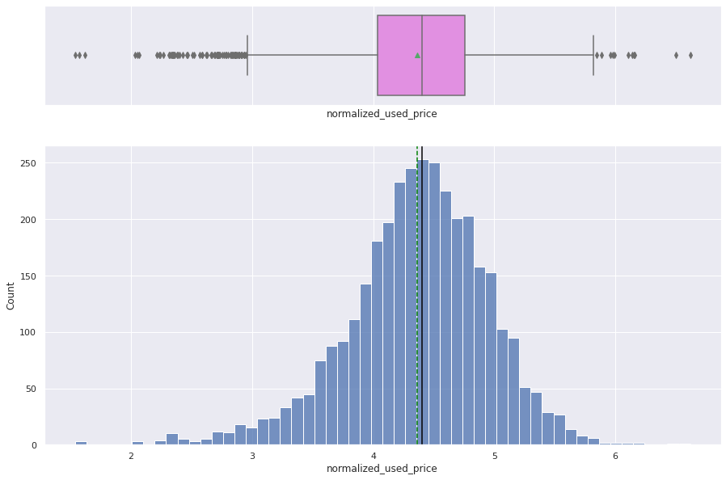
Univariate Analysis
There are various factors affecting the prices of the refurbished handsets/phone purchased by Recell. We shall dive into each variable now to understand their distribution.
Normalized used price of the refurbished devices (in euros)
Average = 4.3 euros
Median = 4.4 euros
The graphs show the distribution of normalized prices for the used phones for the dataset available.
The graph depicts a normal distribution of the prices, and hence the word ‘normalized’.
The least price of a device is recorded to be around 1.53 euros and the maximum price is 6.6 euros.
There are quite a few outliers in the dataset as observed in the boxplot.

Slide 9
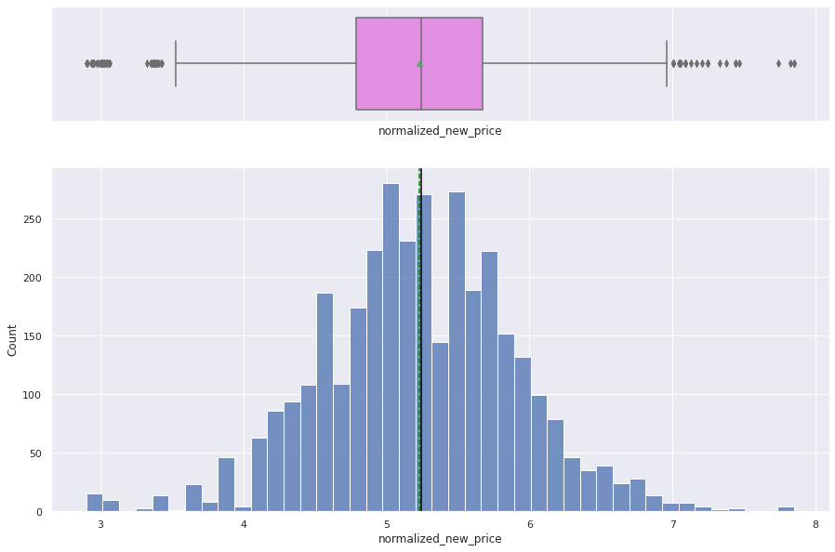
Univariate Analysis
Normalized new price (in euros)
Average = 5.23 euros
Median = 5.24 euros
The graph shows us the distribution of prices of the new devices, if bought from the market, for the same (used) model which was bought by ReCell.
The data seems to follow a normal distribution.
The average and median price of the new devices is understandably more than the average price of the used model.
The mean and median price are observed to be very close to each other, almost equal. The difference is 0.01 euros.
There are quite few outliers in the dataset on both sides.

Slide 10
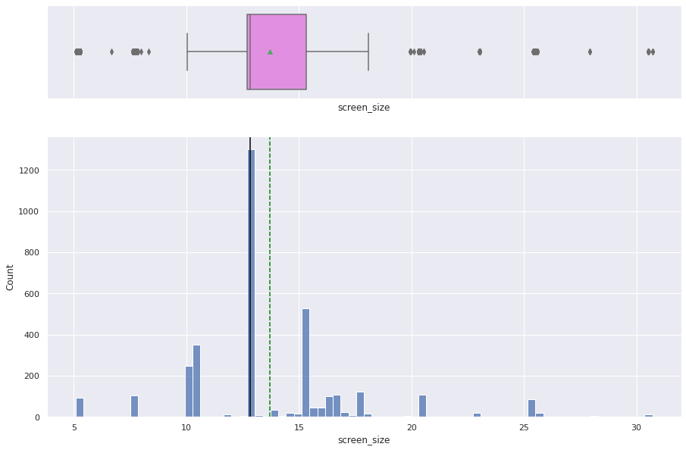
Univariate Analysis
Screen size (in centimeters)
Average = 13.7 cm (5.3 inches)
Median = 12.83 (5.05 inches)
The graph shows the distribution of the screen size among all the handsets bought and recorded in the dataset.
The average screen size is slightly smaller than the industry average of 6 inches. But it may be due to the inclusion of certain brands in the dataset.
The median screen size is understandable, that the greatest number of used devices procured have a 5-inch display, given the kind of brands included in our dataset.
There are a few outliers in the dataset with minimum and maximum screen size of 5.08 cm and 30.71 cm.

Slide 11
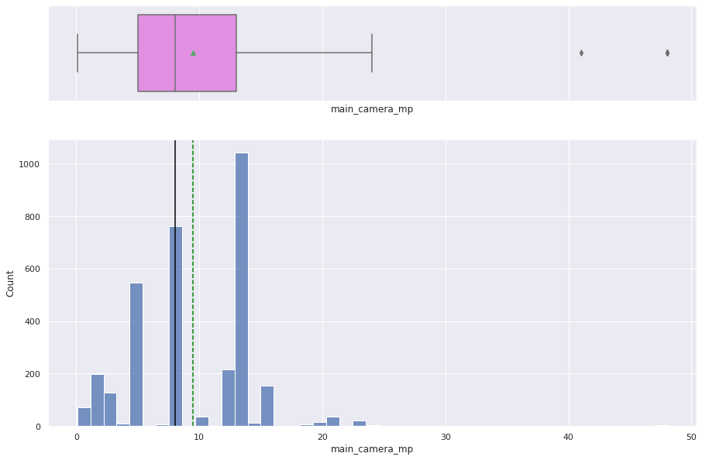
Univariate Analysis
Main camera – in megapixels
Average = 9.4 megapixels
Median = 8 megapixels
The graph shows a right skewed distribution for the kind of main camera (in megapixels) possessed by the refurbished devices
The minimum configuration on the main camera in a device are 0.08 MP and the maximum are 48 MP. Most of the phones seem to have around 13 MP main camera.
The average main camera configuration of 9.4 megapixels is quite close to the industry average of 10 megapixels.
There are just two outliers observed in the dataset which have the values of 42 and 48 MP.

Slide 12
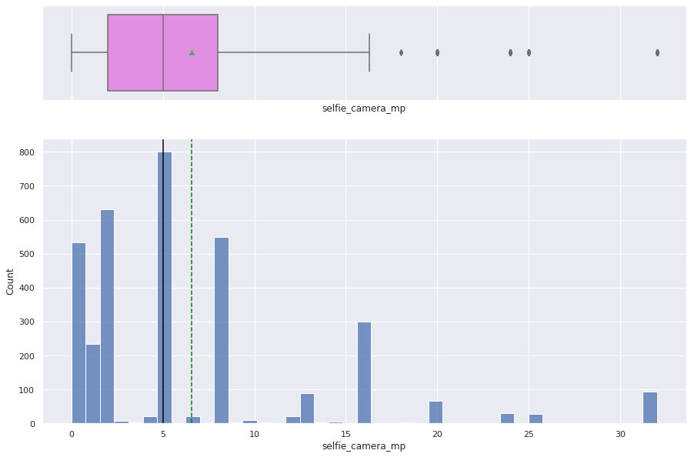
Univariate Analysis
Selfie (front) camera – in megapixels
Average = 6.55 megapixels
Median = 5 megapixels
The graph shows the distribution of the kind of front camera (in megapixels) possessed by the refurbished devices.
The minimum configuration on the front camera in a device is recorded to be 0.00 MP, as some devices do not have a front camera and the maximum is 32 MP.
The distribution is right skewed with a few outliers in the observed data, understandably as anything upwards of 16 MP as a front camera is indeed an anomaly.
The greatest number of phones have a 5 MP front camera.

Slide 13
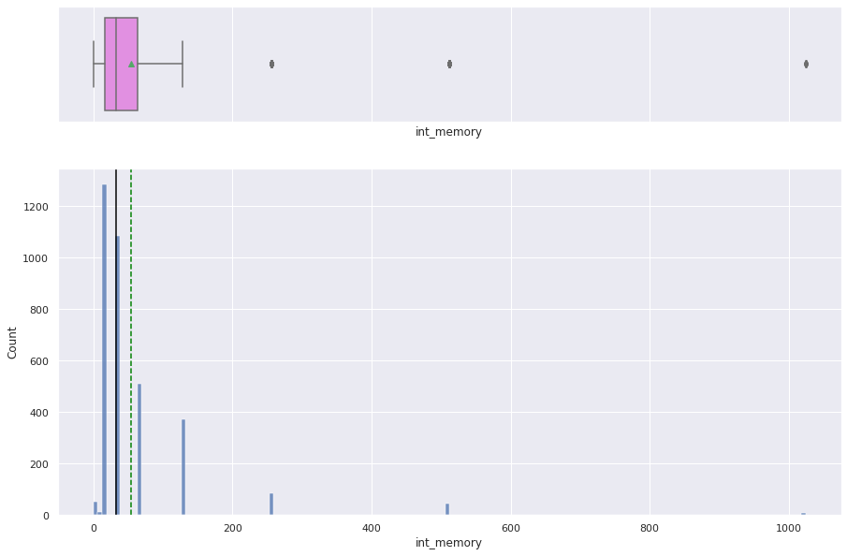
Univariate Analysis
Internal memory (ROM) (in GB)
Average = 54 GB
Median = 32 GB
The internal memory distribution of the phone shows us that most of the phones have an internal memory of 16 GB.
The distribution seems extremely right skewed with a few outliers (8 devices) having an internal memory up to 1 TB.
Most of the phones have 16 GB of internal memory, while there is only one phone with 24 GB ROM.
The minimum internal memory contained by a device is recorded to be 0.01 GB i.e. 10 Mb, which has a high chance of being an old device.

Slide 14
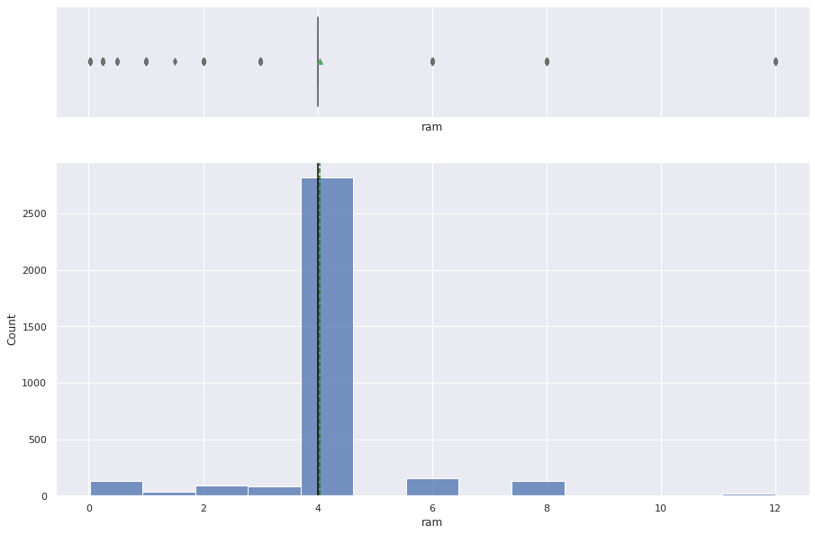
Univariate Analysis
RAM (in GB)
Average = 4 GB
Median = 4 GB
The distribution of the RAM among the devices seems to have a lot of outliers.
The average and the median are observed to be the same, 4GB. 2,815 devices out of 3454 have a 4GB RAM.
The highest RAM observed in the devices is 12 GB and the lowest is 0.02 i.e., 20MB.

Slide 15
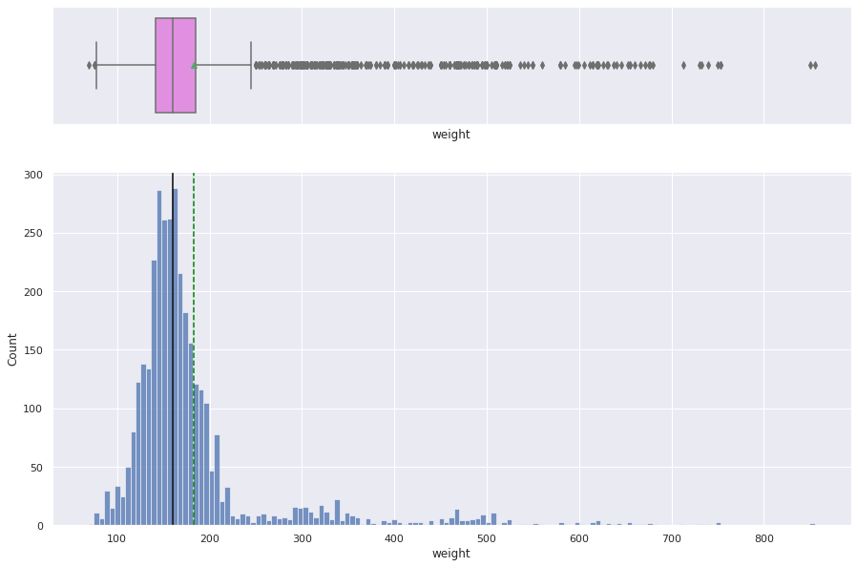
Univariate Analysis
Weight of the phone (in Grams)
Average = 182 grams
Median = 160 grams
The distribution of the weight across the devices is observed to be highly right skewed with a lot of outliers on its right.
The minimum weight observed is 69 grams and the maximum weight is 855 grams.
Most of the phones are observed to weigh 150-160 grams, which is slightly lower than the current industry average of 179.3 grams.

Slide 16
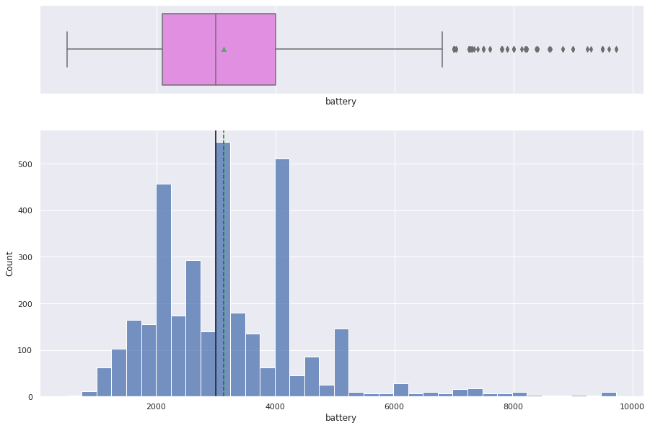
Univariate Analysis
Battery (in mAH)
Average = 3133 mAH
Median = 3000 mAH
The distribution of the battery among the datasets is represented by the graph on the left.
The average mAH of the battery seems to be lower than the industry average which is 4,000-4,500 mAH.
There are high number of devices which have 4000, 3000, and 2000 mAH battery, shared by a total of 899 devices.
The minimum battery capacity is observed to be 500 mAH and the maximum is 9720 mAH.

Slide 17
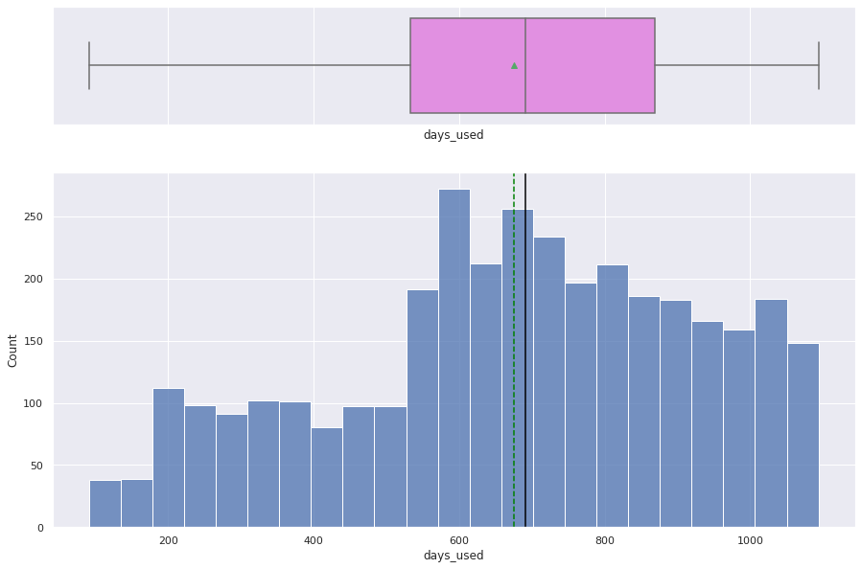
Univariate Analysis
Days used
Average = 674 days
Median = 690 days
The number of days a particular device is used has a high impact on its pricing. The older the device, the lower the price and vice versa.
The distribution of the days used has a high range from some devices being as new as 91 days old, and some as old as being 1094 days (2.9 years), in the dataset received.
Most of the devices are observed to be 600-700 days old in the received dataset.
The standard deviation is observed to be 248 days.

Slide 18
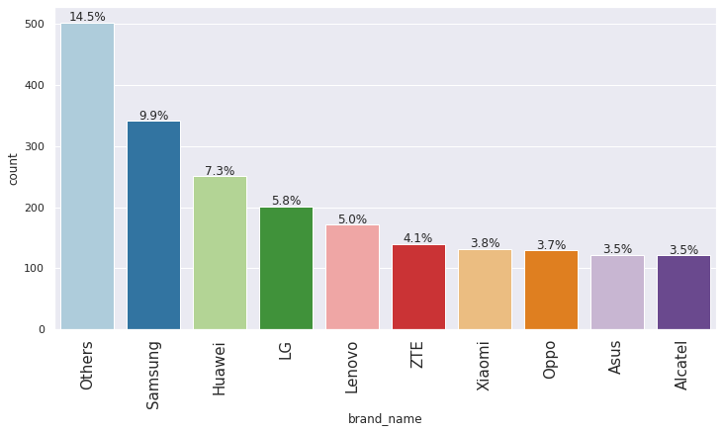
Univariate Analysis
Distribution of handsets across brand names
The graph shows the distribution of refurbished devices purchased across all the brands.
We are analyzing the first 10 brands with the highest distribution among the 34 total number of brands.
The unknown brands categorized under ‘Others’ have the highest percentage (14.5%) of reselling while Samsung being the second most resold brand with 9.9%.
We will have to investigate further to understand if the ‘Other’ brands, when segregated, have any impact on the distribution.
Xiaomi, Oppo, Asus and Alcatel have almost equal percentage of the devices being resold.

Slide 19
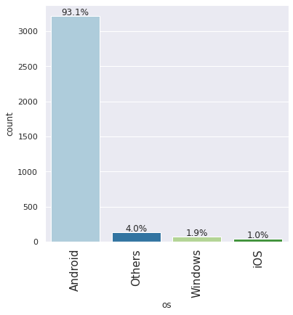
Univariate Analysis
Operating systems
Most of the phones in our dataset run an Android operating system, understandably, as the market share of Android is the highest worldwide, next to iOS.
Although, the reason behind 93.1% of devices being Android in our dataset could be that those are the devices mostly resold to ReCell than iOS devices due to better trade-in options with iPhones.
We will have to investigate further to understand if the ‘Other’ operating system, when segregated, have any impact on the percentage distribution.

Slide 20
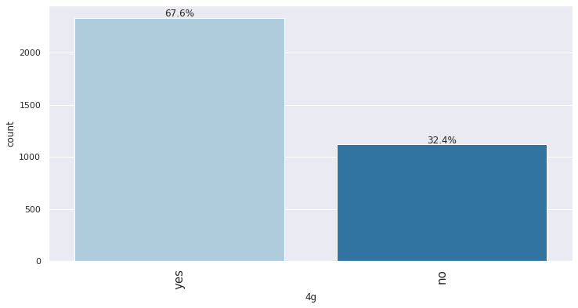
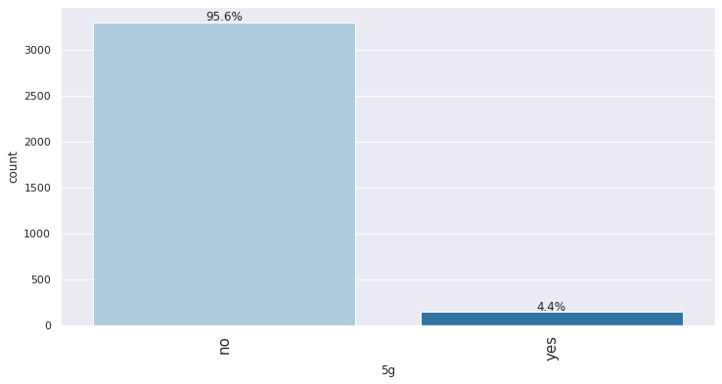
Univariate Analysis
4G & 5G enabled phones
There is a high percentage of phones which have 4G (67.6%) enabled on them compared to 5G (4.4%), understandably. 5G is a more recent technology and people tend to sell their older phones to upgrade to newer one.
It is important to consider this category/factor as it would indeed impact our pricing of the phones to be sold further. 5G enabled phones will have a higher price.

Slide 21
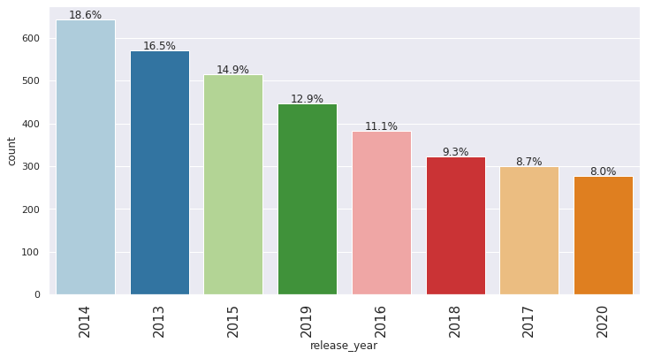
Univariate Analysis
Release year (Baseline year – 2021)
The graph represents the distribution of the devices sold with respect to the year they were manufactured/released.
Most number of devices belong to the year 2014. Understandable, as people want to upgrade their phones from older devices.
Its interesting to know that 2013 has a lower percentage of devices compared 2014. It may be due to the reason that the 2013 model must have been sold in the previous years.
The least number of devices belong to 2020 as the new devices would not be resold in 2021. Our dataset belongs to the year 2021.

Slide 22
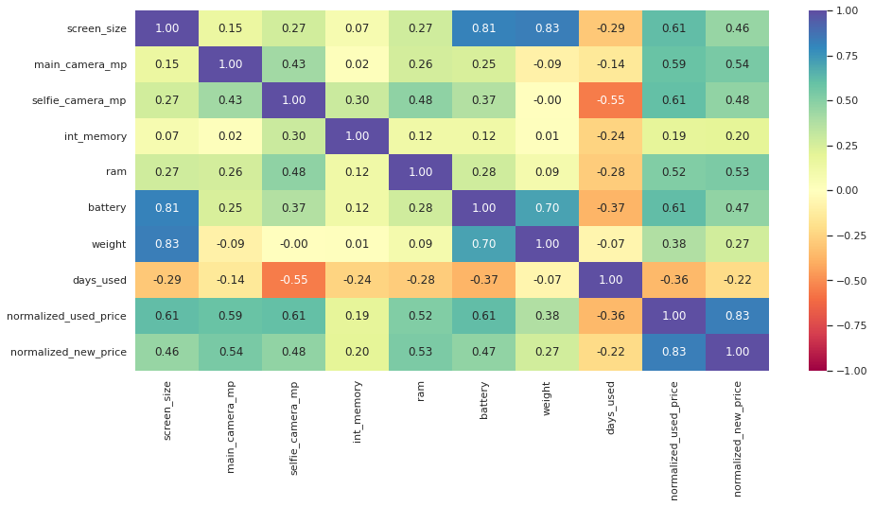
Multivariate Analysis
We are using a heatmap to demonstrate the dependencies and correlation of each variable with respect to other variables.
It is observed that the battery and screen size have a high correlation. Understandably, a bigger phone can accommodate a bigger battery and screen size. Same goes for battery and weight.
The high correlation between the weight and screen size is also self explanatory. Bigger phones will be heavier.
The high correlation between the prices of new vs refurbished phone can be explained as, expensive phones will have a higher reselling price than the cheaper phones, overall.
The ‘days used’ parameter has a negative correlation with all the factors. Understandably, as the older phones will have lesser/lower configurations.

Slide 23
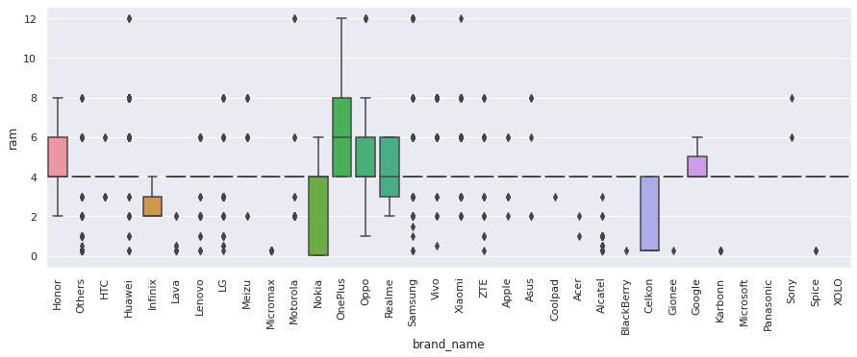
Multivariate Analysis RAM and Brands
The amount of RAM is important for the smooth functioning of a device. The following graph shows the amount of RAM varying across all devices.
The highest RAM possessed by the devices belong to Oppo, Samsung, Xiaomi, Motorola, Oneplus and Huawei.
Most of the Nokia and Celkon phones are observed to have a lower RAM in the range of a few MBs to 6GB.
Oneplus phones are observed to have the highest range of RAM starting from 4GB to 12 GB. All the Onelpus devices have a equal or higher RAM than the average of 4GB.
Google devices also have an equal or higher RAM than the average of 4B, among the devices being resold to ReCell.

Slide 24
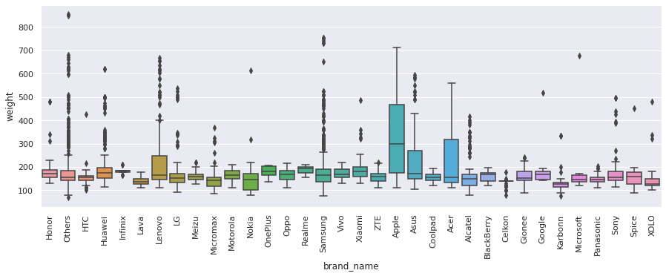
Multivariate Analysis – Weight and brands
People who travel frequently require devices with large batteries to run through the day. But large battery often increases weight, making it feel uncomfortable in the hands. We created a new dataframe of only those devices which offer a large battery (greater than 4500 mAH) and analyzed.
Apple seems to have the most consistent weight in the range of 100 grams to 700 grams due to the lesser range of models sold/available as compared to other brands. Same can be implied about Acer.
Lenovo, Samsung and other brands have a lot of outliers This could be because of the higher range of models sold/available as compared to others and therefore the varying range of battery size and weight.

Slide 25
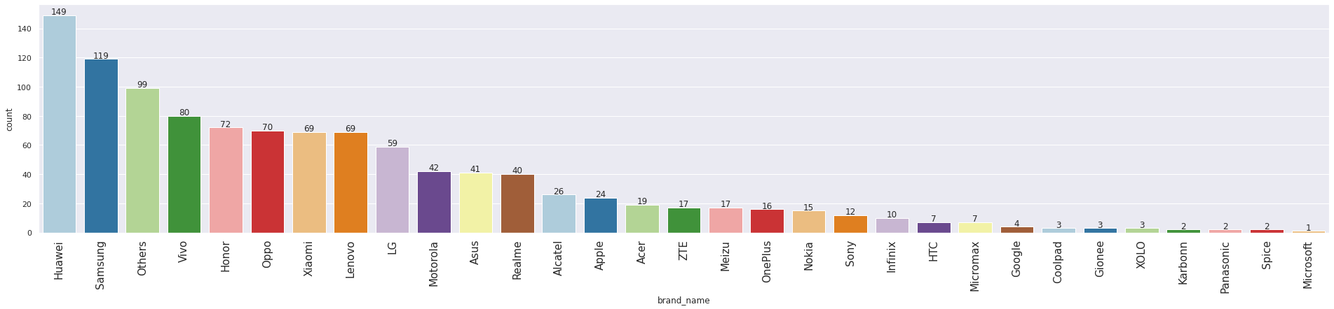
Multivariate Analysis – Screen size and brands
People who buy phones and tablets primarily for entertainment purposes prefer a large screen as they offer a better viewing experience. We created a new dataframe of only those devices which are suitable for such people (6 inches and above) and analyzed.
Most of the Huawei devices (149) have a bigger screen than 6 inches, next to Samsung (119), in our dataset.
Microsoft has the least (1 no.) of devices, in our dataset which have a screen size bigger than 6 inches.

Slide 26
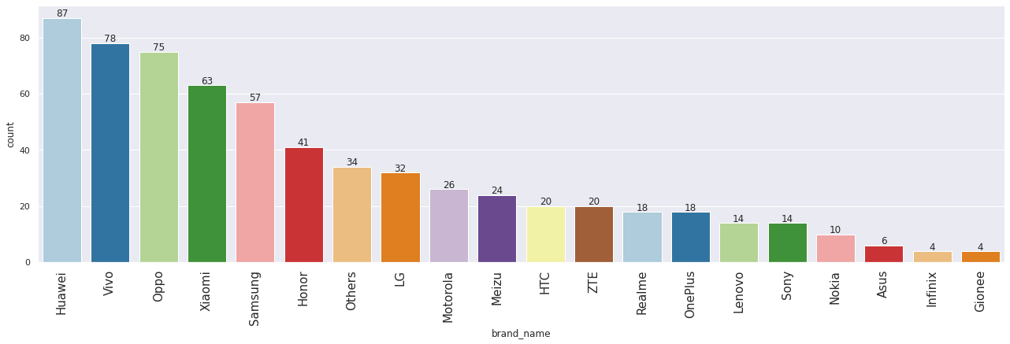
Multivariate Analysis – Selfie Camera and brands
Everyone likes a good camera to capture their favorite moments with loved ones. Some customers specifically look for good front cameras to click cool selfies. We created a new dataframe of only those devices which are suitable (greater than 8 MP) for this customer segment and analyzed.
Huawei has the greatest number of devices (87) which have a high spec camera more than 8 MP, next to Vivo (78), in our dataset.
The least number of phones having a camera spec more than 8 MP belong to Gionee brand.

Slide 27
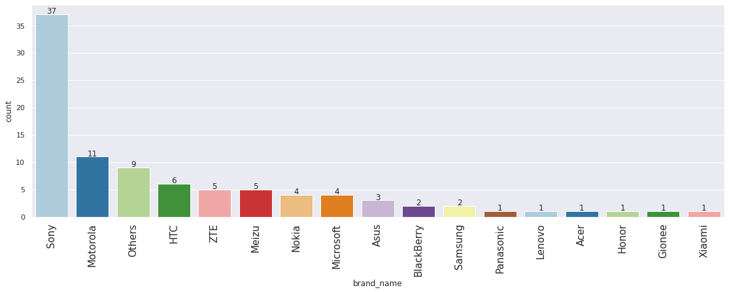
Multivariate Analysis – Main Camera and brands
We did a similar analysis for the main camera module, as that is an important factor as well while deciding on a new phone purchase. We recorded all the phones which have a camera configuration upwards of 16 Megapixels.
As per the data, Sony has the greatest number of phones which possess a camera better than 16 megapixels, next to Motorola.
Xiaomi, Panasonic, Lenovo, Acer, Honor and Gionee each have one device which has a camera module better than 16 megapixels in our dataset.

Slide 28
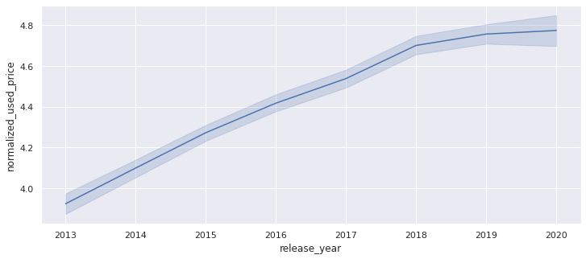
Multivariate Analysis – Price and Release year
Price and release year are positively linear to each other.
It is understandable, as the older phones will be cheaper as their demand would be less.
Similarly, the newer the device’s release date, the higher the configuration of that device contributing to the higher demand of that device.
This would be an important factor to take into consideration in our regression model about predicting the price of a used/refurbished phones and tablets.

Slide 29
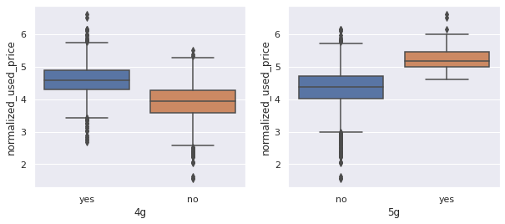
Multivariate Analysis – Price and Network support
The prices would vary with respect to the device supporting 4G or 5G.
As observed in the boxplots, the average price of devices supporting 5G is higher than the ones supporting 4G.
Also, the range of the prices supporting 5G is much higher than the devices supporting 4G.
This would be an important factor to take into consideration in our regression model about predicting the price of a used/refurbished phones and tablets.

Slide 30
DATA PROCESSING

Slide 31
Missing value treatment
Following are the columns which are observed to have missing values
Column name | Column name description | Missing values (nos)
main_camera_mp | Main camera | 179
selfie_camera_mp | Selfie Camera | 2
int_memory | Internal memory | 4
ram | RAM in GB | 4
battery | Battery capacity | 6
weight | Weight of the phone | 7
Each column will have to be dealt by imputing the missing value with the median of that column.
Although, we will be grouping the dataset appropriately so that the range of values imputed belong to the proper differentiation according to the brand name and release year.
The grouping will allow us to impute the appropriate value of the specs contained by the phones of specific years.

Slide 32


Missing value treatment
Imputing missing values with median value
PROCESS
OUTPUT
For Internal Memory and RAM columns
Grouping By: ‘Brand name’ and ‘Release year’
This grouping will enable us to impute the appropriate values (median of that column), as every brand has their own specifications.
Second grouping will be done based on the ‘Release year’, since the specification/technology varies every year.
Column name | Column name description | Missing values (nos)
main_camera_mp | Main camera | 179
selfie_camera_mp | Selfie Camera | 2
int_memory | Internal memory | 0
ram | RAM in GB | 0
battery | Battery capacity | 6
weight | Weight of the phone | 7
Column name | Column name description | Missing values (nos)
main_camera_mp | Main camera | 10
selfie_camera_mp | Selfie Camera | 0
int_memory | Internal memory | 0
ram | RAM in GB | 0
battery | Battery capacity | 0
weight | Weight of the phone | 0
For Main camera, Selfie Camera, Battery and Weight
To impute the missing values in these columns with the Median values of the respective columns, we grouped the data wrt just the ‘Brand name’.

Slide 33

Missing value treatment
Imputing missing values with median value
PROCESS
OUTPUT
For Internal Main Camera:
As we observed in the previous slide, the ‘Main camera’ column still had some missing values left.
We will impute the remaining missing values (10 nos.) in the ‘Main Camera’ column with the median values of that same column.
Column name | Column name description | Missing values (nos)
main_camera_mp | Main camera | 0
selfie_camera_mp | Selfie Camera | 0
int_memory | Internal memory | 0
ram | RAM in GB | 0
battery | Battery capacity | 0
weight | Weight of the phone | 0

Slide 34
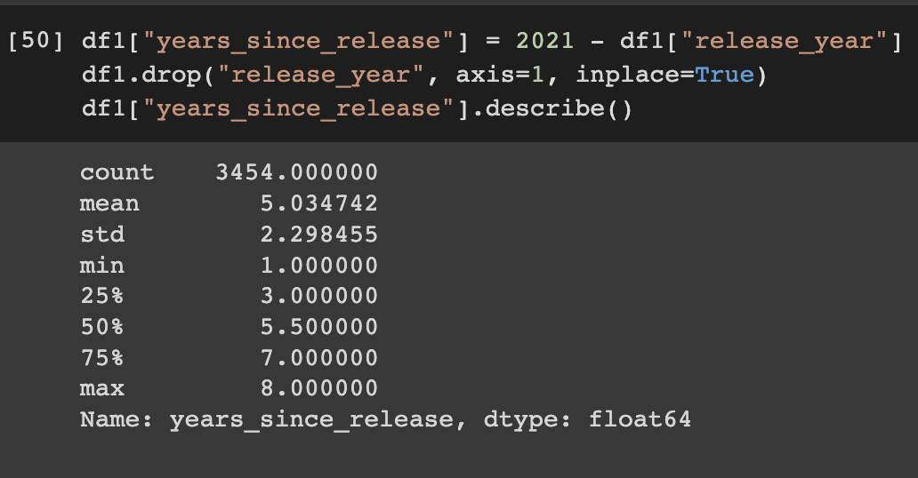
Feature Engineering
Creating new column ‘ years_since_release’
We created a new column ‘years_since_release’ by subtracting the release year from 2021.
We take 2021 as the baseline year, as the dataset belongs to that year.
The objective behind creating a new column is to help our analysis with one of the major factors, which is the age of the phone, while predicting the price of the phone.
As we can see the average age of the phone is around 5 years, with the oldest phone being 8 years old and the newest phone being 1 year old.

Slide 35
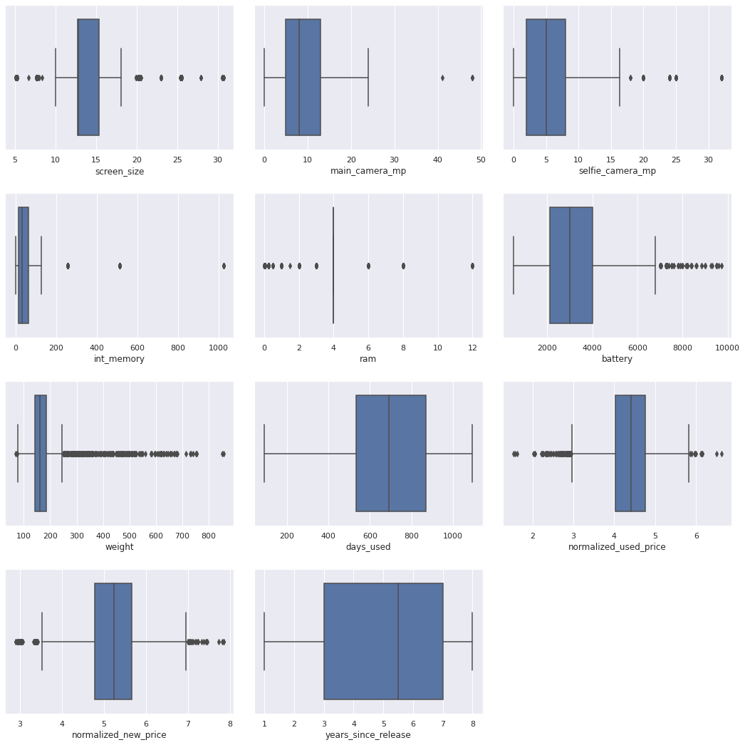
Outliers check
There are quite a few outliers in our data. Here we are looking at the columns Screen size, Main camera, Selfie camera, internal memory, RAM, Battery.
We will not be treating these outliers as all the outlier values seem to be proper values
Screen size: Can be as small as small as 5 cm and as big as 30 cm.
Main camera and Selfie camera: Some Chinese manufacturers do produce phones with 48 MP main cameras and over 30MP selfie camera.
Internal memory & RAM: Indeed, phones do have 1TB of internal memory and RAM ranging from few MBs to 12 GB, making it a proper value.
Battery: Same goes for the battery, the battery capacity can go up to 10,000 mAH.

Slide 36
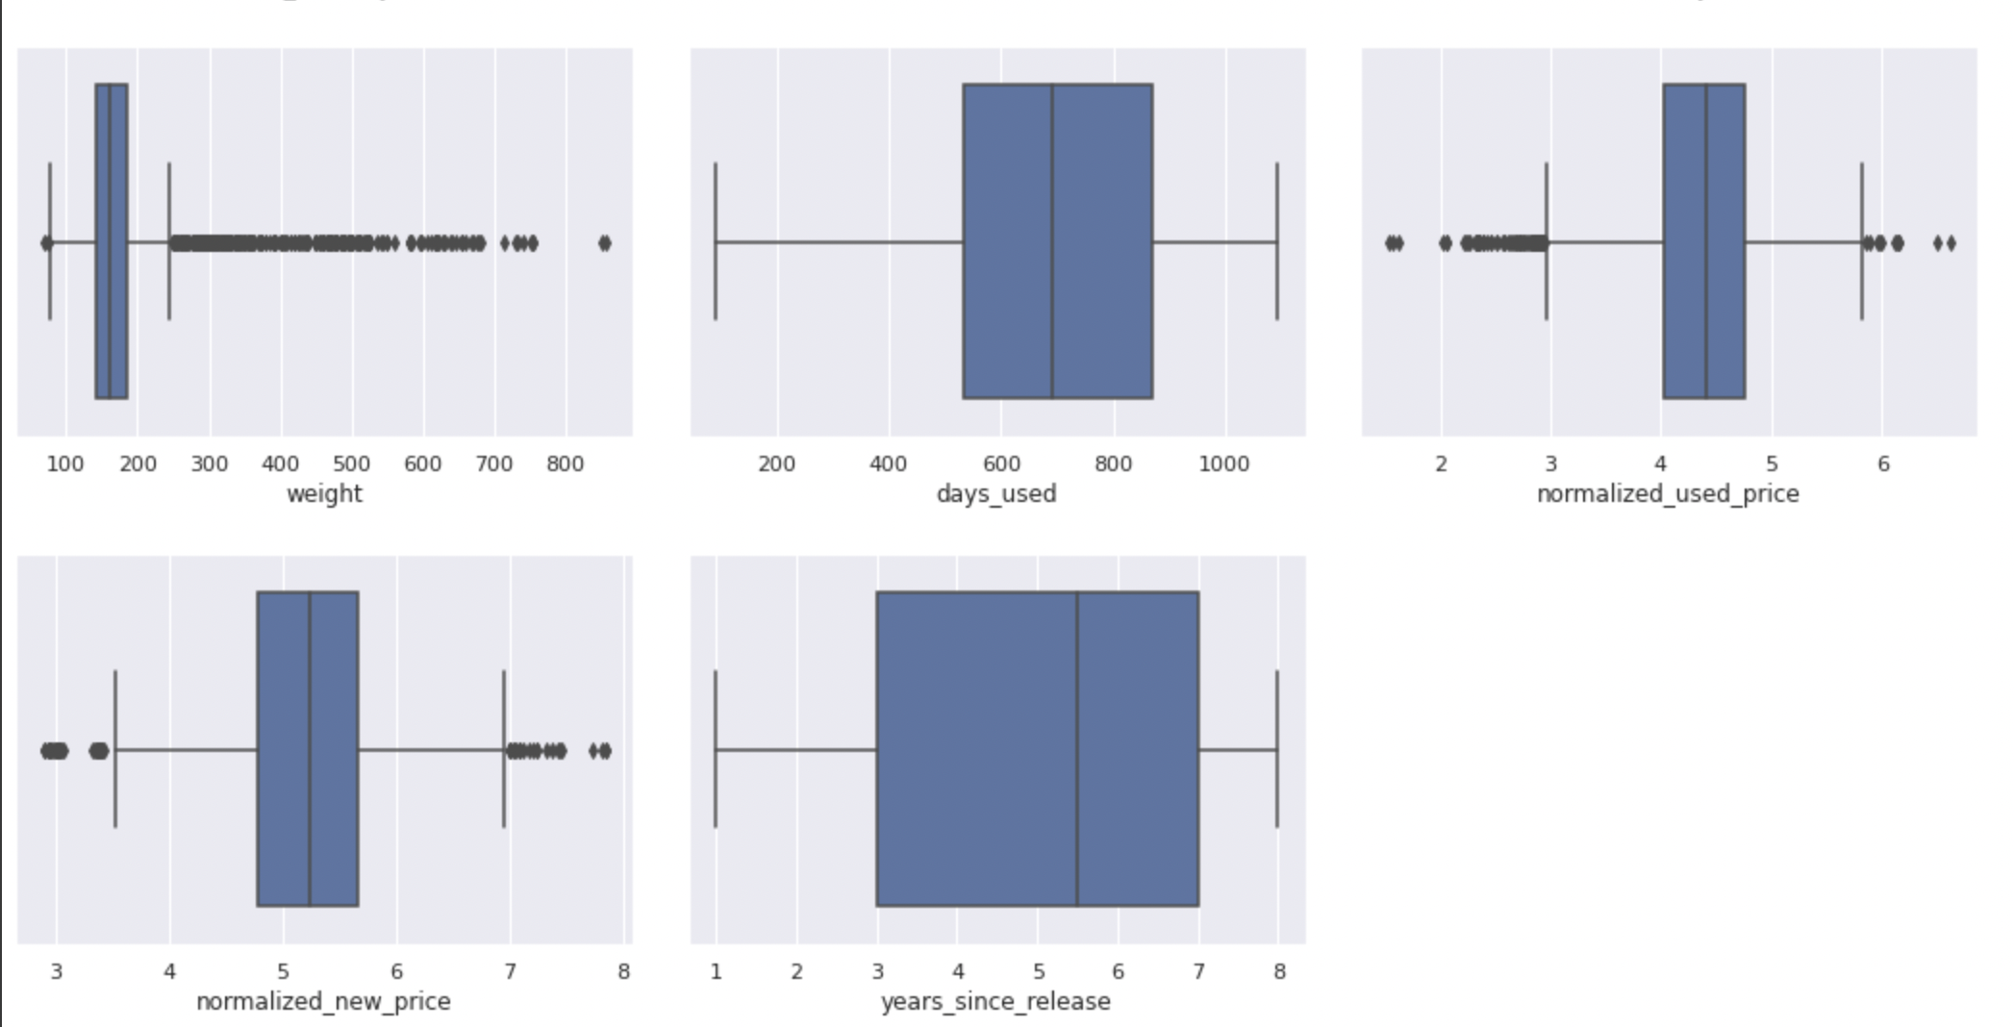
Outliers check
The columns Weight, Normalized Used price and Normalized new price seem to have outliers in their data.
Although, these outliers shall not be treated as well, as they are proper values.
Weight: A phone can indeed weigh more than 800 grams, depending on the kind of material used for manufacture.
Prices: The prices as well can have a varied range and can be proper values, as long as its not negative.

Slide 37

Data Preparation for Modelling
Define Independent and dependent variables split datasets accordingly.
Add intercept/constant.
Get dummy variables for categorical columns.
Split datasets into train and test sets. We will apply a 70:30 ratio.
70% - Training set and 30% - Test set.

Slide 38

Step 1: Create subsets of independent and dependent variables
Independent Variables : ‘X’ Dataset
Dependent Variable : ‘y’ Dataset
Brand name
OS
Screen size
4G
Days used
Normalised Used prices
5G
Main camera
Selfie camera
Internal Memory
Norm. new price
Linear Regression
RAM
Battery
Weight
Years since release

Slide 39
Step 3 – Getting Dummy Variables
Categorical Variables
When one or more predictors are categorical. A set of dummy variables or indicator variables is introduced corresponding to each categorical variable. A discrete variable with 𝑚 categories is represented by a set of 𝑚−1 dummy variables.
We want to predict the prices of the used phones using the regression model.
Getting dummy variables using the one hot coding technique on the categorical variables will enable us to have the coefficients for these variables as well in our regression model/equation.
Column name | Column name description
brand_name | Name of manufacturing brand
os | OS on which the device runs
4g | Whether 4g is available or not
5g | Whether 5g is available or not
Column name | Base variable | Dummy variables
os | os_android | os_windows, os_ios, os_others
4g | 4g_no | 4g_yes
5g | 5g_no | 5g_yes
brand_name | Similar to above | Similar to above

Slide 40



Step 4 – Split Datasets
Received dataset
used_device_data.csv
Training set
Testing set
X_train
y_train
X_test
y_test
Independent variables
Dependent variable
Independent variables
Dependent variable

Slide 41
MODEL BUILDING – LINEAR REGRESSION

Slide 42
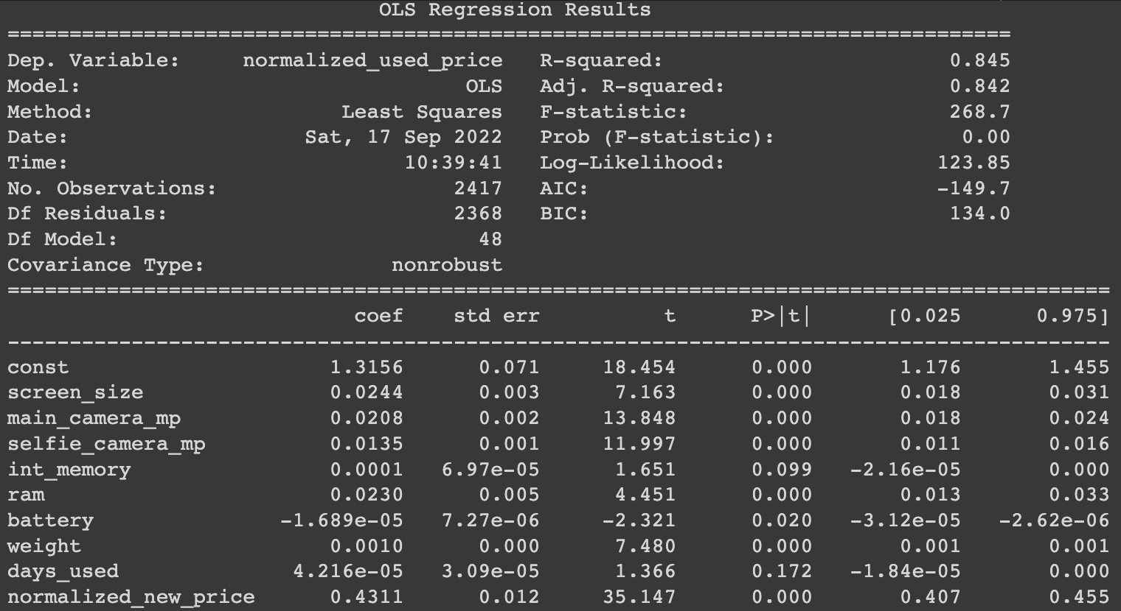
Model Building – Linear Regression
Step 1: Run the datsets through OLS regression method.
Step 2: Anlyse the major factors/components influencing the health of our regression model
Step 3: Decide the next steps wrt cleaning up the that further based on the anlysis done in Step 2.
1. Adjusted. R-squared: It reflects the fit of the model.
- Adjusted R-squared values generally range from 0 to 1, where a higher value generally indicates a better fit, assuming certain conditions are met.
- In our case, the value for adj. R-squared is 0.842, which is great.
2. Const coefficient (const): It is the Y-intercept.
- It means that if all the predictor variable coefficients are zero, then the expected output (i.e., Y) would be equal to the *const* coefficient.
- In our case, the value for `const` coefficient is 1.315
3. Coefficient of a predictor variables: It represents the change in the output Y due to a change in the predictor variable (everything else held constant).
- In our case, the coefficient of ‘normalized new price` is 0.4311.

Slide 43
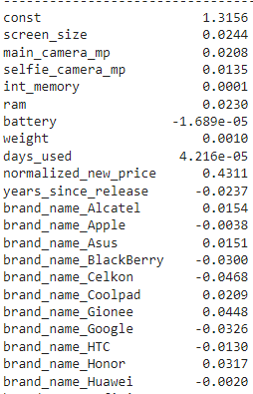
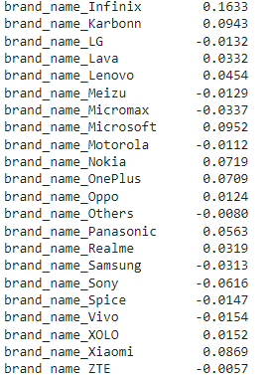
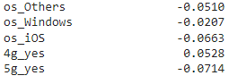
Model Building – Linear Regression
MODEL COEFFICIENTS
Column Name
Coefficients
Column Name
Coefficients
Column Name
Coefficients

Slide 44
Model Performance Check – Training performance
Training Set
Testing Set
Parmeters | Values
RMSE | 0.229884
MAE | 0.180326
R-squared | 0.844886
Adj R squared | 0.841675
MAPE | 4.326841
Parmeters | Values
RMSE | 0.238358
MAE | 0.184749
R-squared | 0.842479
Adj R squared | 0.834659
MAPE | 4.501651
Observations:
The training R squared is 0.84, which means that the model is not underfitting.
The train and test RMSE and MAE are comparable, so the model is not overfitting either.
MAE suggests that the model can predict the prices of used/refurbished phones within a mean error of 0.184 on the test data.
MAPE of 4.5 on the test data means that we are able to predict within 4.5% of the normalized used prices.

Slide 45
CHECKING LINEAR REGRESSION ASSUMPTIONS

Slide 46
Linear Regression Assumptions
The very first step after building a linear regression model is to check whether our model meets the assumptions of linear regression. These assumptions are a vital part of assessing whether the model is correctly specified.
The predictors are not correlated to each other.
No Multicollinearity
Variance inflation factor. We will drop the variables with high VIF.
Predictor variables must have a linear relation with the dependent variable.
If the residuals are not independent, then the CI of the coefficient estimates will be narrower and make us incorrectly conclude a parameter to be statistically significant.
Make a plot of fitted values vs residuals. If they don't follow any pattern, then we say the model is linear and residuals are independent. Otherwise, the model is showing signs of non-linearity and error are not independent.
Linearity and independence of variables
The random error terms (residuals) are normally distributed.
Normality of error terms
A histogram of residuals can give an idea about the normality. A Q-Q plot of residuals should make a straight-line plot. A Shapiro Wilks test.
The variance of errors is constant for all values of independent variable X
No Heteroscedasticity
The residual vs fitted values plot can form an arrow shape or any other non-symmetrical shape in case of heteroscedasticity.

Slide 47
Test for Multicollinearity
Determination
Treatment
Variance inflation factor (VIF) : It is a measure of how much the variance of the estimated regression coefficient βk is "inflated" by the existence of correlation among the predictor variables in the model.
Drop every column one by one that has a VIF score greater than 5.
Look at the adjusted R-squared and RMSE of all these models.
Drop the variable that makes the least change in adjusted R-squared.
Check the VIF scores again.
Continue till you get all VIF scores under 5.
We will test for multicollinearity using VIF.
If VIF is 1 then there is no correlation between the predictors/variables.
If VIF exceeds 5 or is close to exceeding 5, we say there is moderate multicollinearity.
If VIF is 10 or exceeding 10, it shows signs of high multicollinearity.
Column name | Adj R square after dropping column | RMSE after dropping column
screen_size | 0.838381 | 0.234703
weight | 0.838071 | 0.234928
High VIF predictor variables (>5)
Column name | VIF
screen_size | 7.677290
weight | 6.396749
Treatment remarks:
The adj R squared and RMSE value is not disturbed, it is still very close to what we obtained during the model performance check, as desired.
Even the VIF scores of all the other variables are still under 5, as desired.

Slide 48
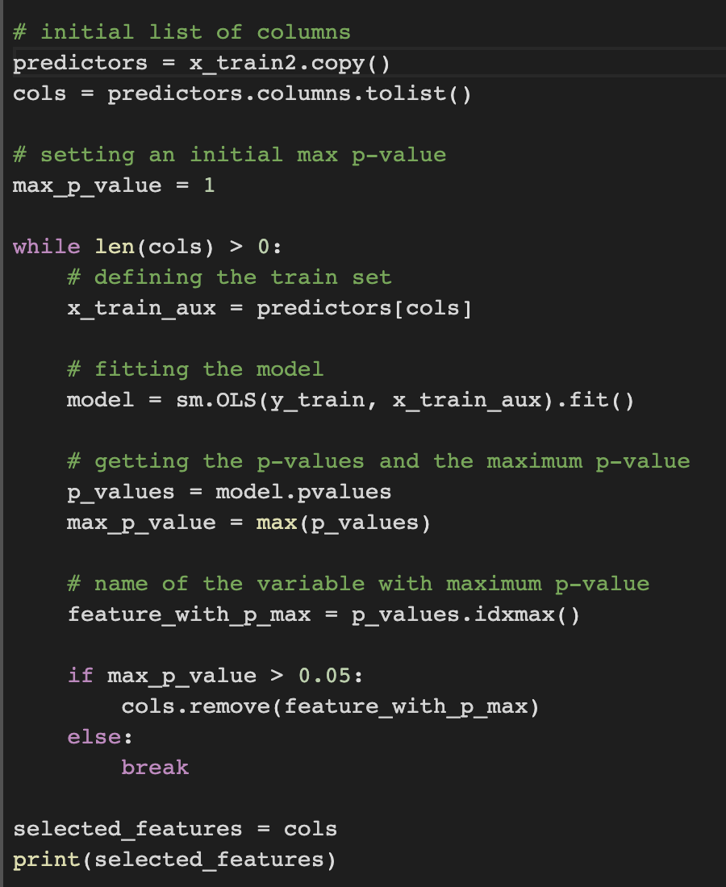
Test for Multicollinearity – Dropping high p-value variables
The described process can be done manually by picking one variable at a time that has a high p-value, dropping it, and building a model again. But that might be a little tedious and using a loop is more efficient, as displayed below.
Determination
We will drop the predictor variables having a p-value greater than 0.05 as they do not significantly impact the target variable.
But sometimes p-values change after dropping a variable. So, we'll not drop all variables at once.
Instead, we will do the following:
Build a model, check the p-values of the variables, and drop the column with the highest p-value.
Create a new model without the dropped feature, check the p-values of the variables, and drop the column with the highest p-value.
Repeat the above two steps till there are no columns with p-value > 0.05.

Slide 49
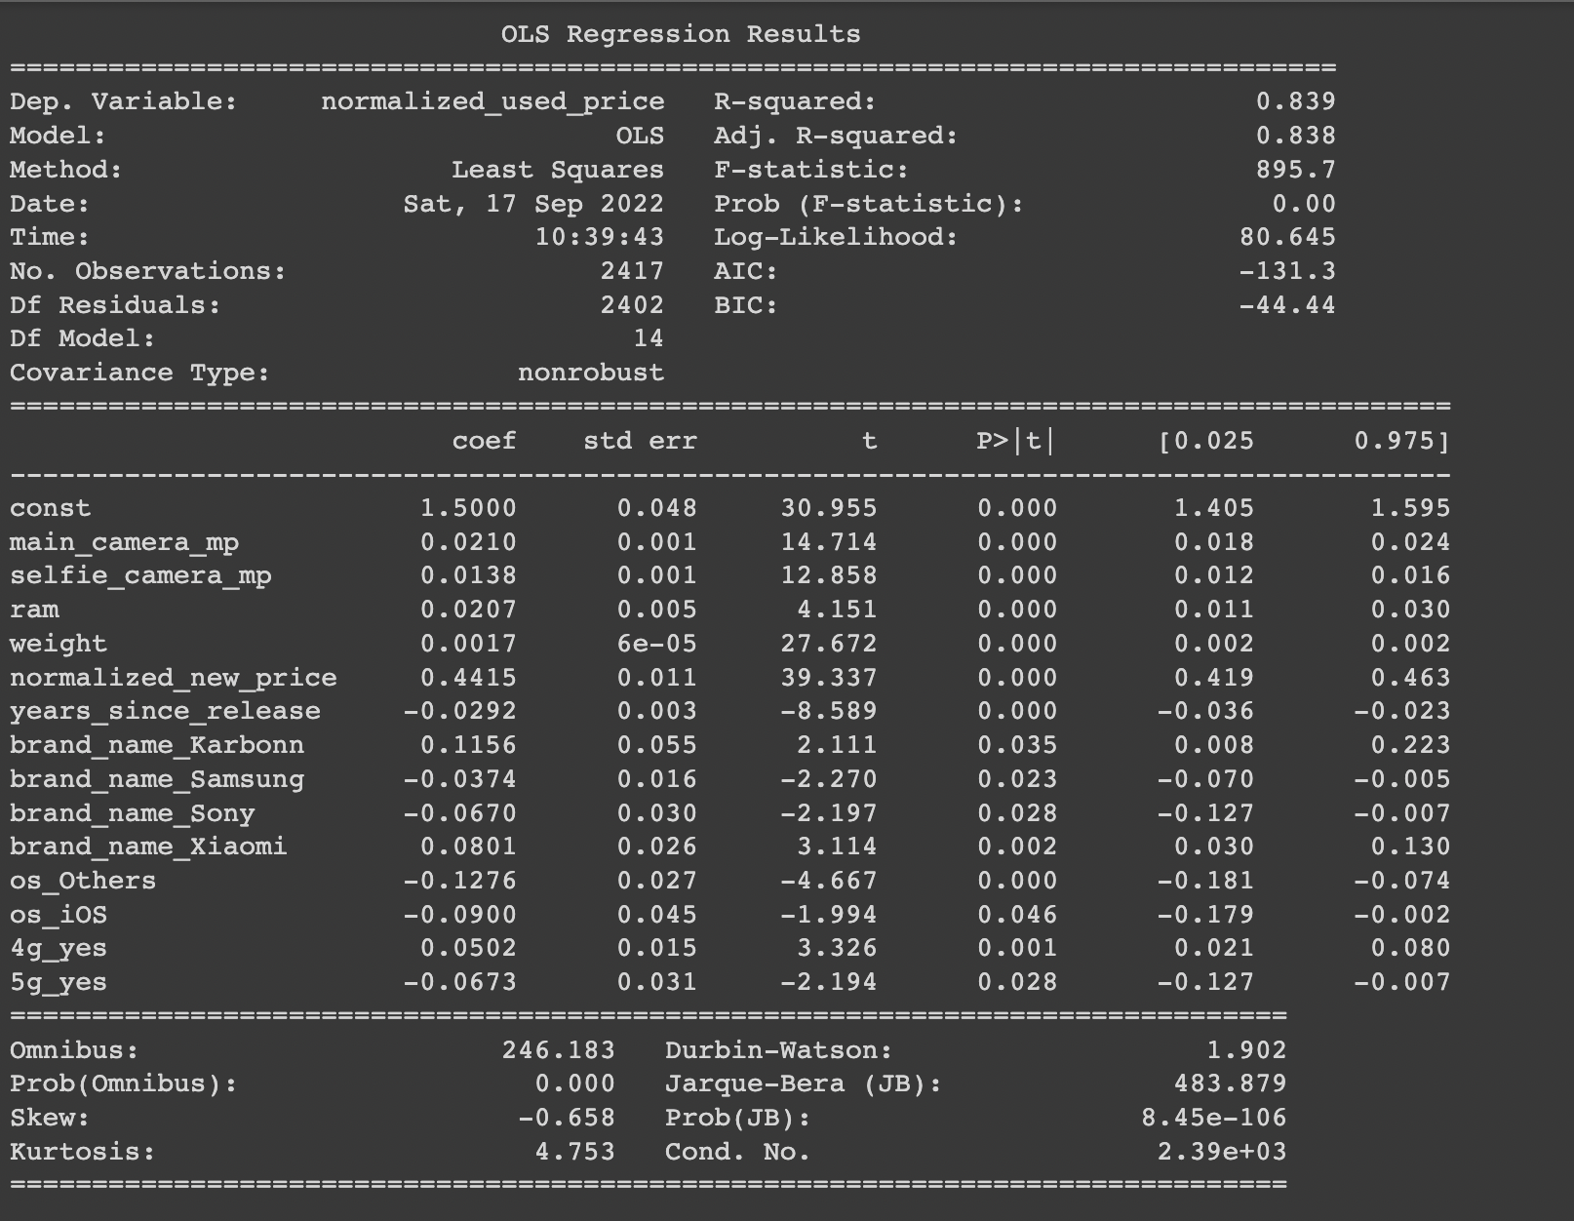
Test for Multicollinearity – Dropping high p-value variables
Treatment
The OLS regression results, clearly state that the predictors present in our (x_train3) dataset have a p-value less than 0.05.
Performance check:
Now adjusted R-squared is 0.83, i.e., our model can explain ~83% of the variance
The adjusted R-squared in olsmod1 (where we considered the variables without multicollinearity) was 0.842. This shows that the variables we dropped were affecting the model slightly, but not to a great extent.
RMSE and MAE values are comparable for train and test sets, indicating that the model is not overfitting.
Parmeters | Training set | Testing Set
RMSE | 0.23403 | 0.241434
MAE | 0.18275 | 0.186649
R-squared | 0.83924 | 0.838387
Adj R squared | 0.838235 | 0.836013
MAPE | 4.395407 | 4.556349

Slide 50
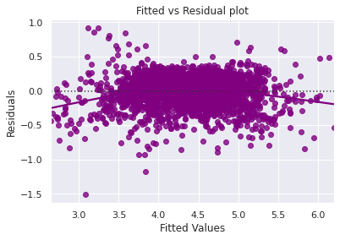
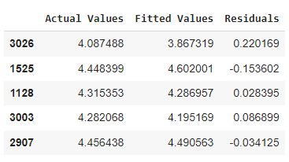
Test for Linearity and Independence
We create a dataframe with Actual values, Fitted values and residual values.
Then plot the fitted values and residuals on a scatterplot
Conclusions:
The scatterplot does not show any pattern. Hence the assumptions of linearity and independence are satisfied.
If there was any pattern observed in this plot, we consider it as signs of non-linearity in the data and a pattern means that the model doesn't capture non-linear effects.
Also, if the assumption is not followed, or satisfied, we would have tried to transform the variables and make the relationships linear.

Slide 51
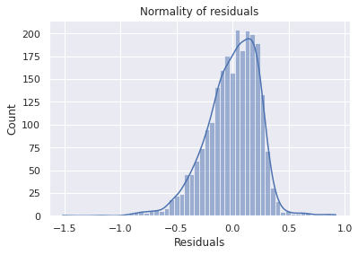
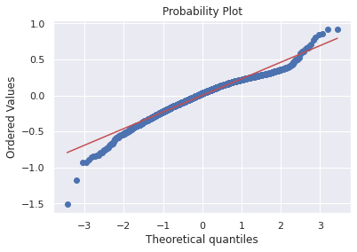

Test for Normality
Histogram
Q-Q Plot
The initial histogram shows almost a normal distribution when the residuals are plotted over it.
The residuals more or less follow a straight line except for the tails
Shapiro Wilks Test:
Null Hypothesis: The residuals are distributed normally.
Alternate Hypothesis: The residuals are not distributed normally.
Conclusions:
Since p-value<0.05, we reject the null hypothesis and conclude that the residuals are not normal as per the Shapiro Wilk’s Test.
Strictly speaking, the residuals are not normal. However, as an approximation, we can accept this distribution as close to being normal.
Hence, the assumption is satisfied.
P - Value
6.995328206686811e-23

Slide 52
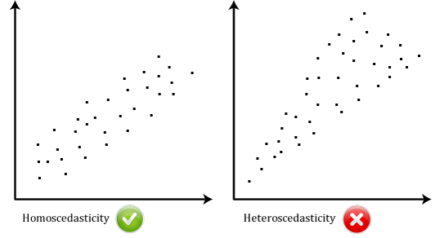
Test for Homoscedasticity
The residual vs fitted values plot can be looked at to check for homoscedasticity. In the case of heteroscedasticity, the residuals can form an arrow shape or any other non-symmetrical shape.
Goldfeldquant Test
Null Hypothesis: The residuals are homoscedastic.
Alternate Hypothesis: The residuals are not homoscedastic.
We perform this test using the sms.het_goldfeldquandt function in the statsmodels.stats.api library. If we get a p-value > 0.05 we can say that the residuals are homoscedastic. Otherwise, they are heteroscedastic.
P - Value
0.440197065
Conclusion:
Since p-value>0.05, we fail to reject the null hypothesis and conclude that the residuals are Homoscedastic.
That means that the residuals have a constant variance throughout their distribution.

Slide 53
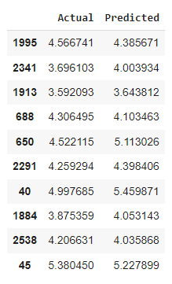
Predictions on Test Data
Now that we have checked all the assumptions of linear regression and they are satisfied, let's go ahead with prediction.
Conclusion:
We can observe here that our model has returned pretty good prediction results, and the actual and predicted values are comparable.

Slide 54
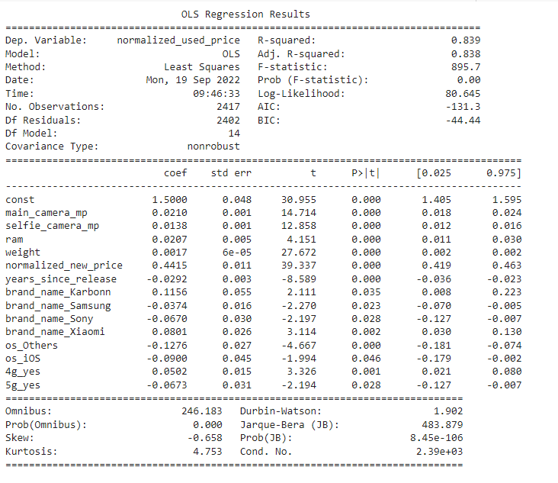
Final Model Summary – Regression Results
Let's recreate the final model and print its summary to gain insights.
Train and Test Performance
Parmeters | Training set | Testing Set
RMSE | 0.23403 | 0.241434
MAE | 0.182751 | 0.186649
R-squared | 0.83924 | 0.838387
Adj R squared | 0.838235 | 0.836013
MAPE | 4.395407 | 4.556349

Slide 55
Final Model Summary – Regression Results
Following are the conclusions we can draw from the Regression results
The model is able to explain approx. 83% of the variation in the data.
The train and test RMSE and MAE are low and comparable. So, our model is not suffering from overfitting.
The MAPE on the test set suggests we can predict within 4.39% of the ReCell data, which is great.
Hence, we can conclude the model olsmodel_final is good for predictions as well as inference purposes.
The Durbin Watson statistic of 1.9, which is very close to 2, suggests that there is no autocorrelation among the predictor variables.
Final Regression equation:
Normalized_used_price = 1.5 + 0.0210 (main camera) + 0.0138 (selfie camera) + 0.0207 (ram) + 0.0017 (weight) + 0.4415 (normalized_new_price) – 0.0292 (years_since_release) + 0.1156 (Karbonn phone) – 0.0374 (Samsung phone) - 0.067 (Sony phone) + 0.0801 (Xiaomi phone) – 0.1276 (Other OS) – 0.09 (IOS OS) + 0.05 (4G phone) – 0.0673 (5G phone)
Constant/Intercept
Coefficient
Predictor/variable

Slide 56
Conclusions and Recommendations
Significance of predictors: The model is able to explain ~83% of the variation in the data and within ~4% of the normalized used prices on the test data, which is good.
If the RAM of a phone increases by one unit, then its price increases by 0.0207 units, all other variables held constant.
If the normalized new price of a phone increases by one unit, then the used price increases by 0.4415 unit, all other variables held constant. This variable is observed to have the most impact on the pricing of the refurbished phone.
If the number of years since release of the phone increases by one unit, then its used price decreases by 0.0292 units, all other variables held constant.
The prices for an IOS running device will be 0.09 units less than those running Andriod.
The price of a 4G enabled device will be 0.05 units more than a device which does not support 4G.
If the weight of the phone increases by one unit, the price of the used phone increases by 0.0017 units, all other variables held constant.

Slide 57
Conclusions and Recommendations
Key takeaways and recommendations:
As the used prices of the phone are heavily impacted by the year the phone was released, and newer phones are priced more expensive, we should look for increasing our marketing efforts to acquire greater number of people willing to sell their phones on our platform.
Also, the newer phones will have more demand as they would have the latest specifications. Attractive offers and add-ons would allow us to capture more customers that wish to buy these refurbished phones.
ReCell can gather data about the customer’s gender, location, age, occupation etc. which could help us understand the needs and trends based on these factors.
Further investigation about the ‘Other’ brands can help us understand the distribution better as it shares 14.5% of the total phones in our database. The segregation can help us further to deduce the trends and improve our prediction algorithm.

